Slide 1

HR ANALYTICS
Presented by: Batch 1 (DA_P6)
- Preeti Nayak
- Savita Salian - Chandan Sharma - Radhika Kapoor

Slide 2

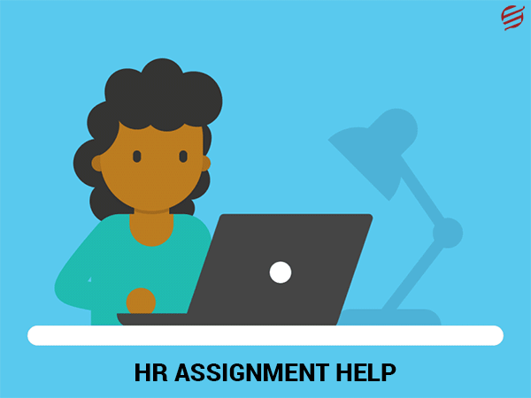
HR Analytics
In any company, hiring and retaining employees are complex tasks that require capital, time, and skills.
Through this analysis, we will predict whether the potential candidate will join the organization or not.
The findings will support more effective and efficient ways of finding potential candidates and preventing the company from incurring any losses.

Slide 3
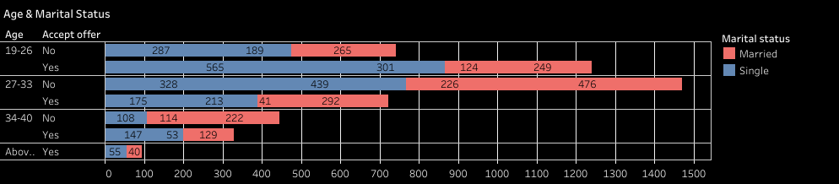

Age & Marital Status
Age grp between 19-26 will accept the offer with Male candidates being the highest.
An equal number of candidates between age group 27-33 will reject the offer irrespective of their Marital Status. Also the acceptance ratio for that age group is less .
Candidates above 40 will most likely accept the offer.

Slide 4
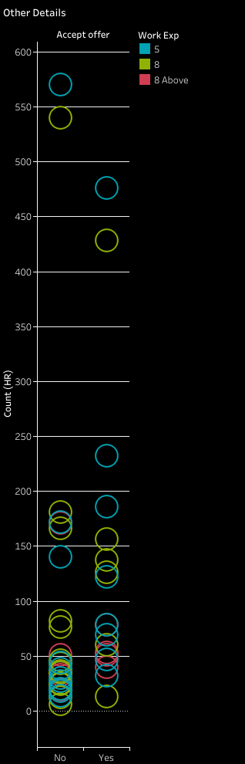

Past Salary & Work Exp
Maximum offer will be accepted and rejected by candidates with 5 yrs & 8 yrs of experience.
The last drawn salary for rejected candidates is showing as 3.5-7k and the most probable reason could be higher salary expectation.

Slide 5
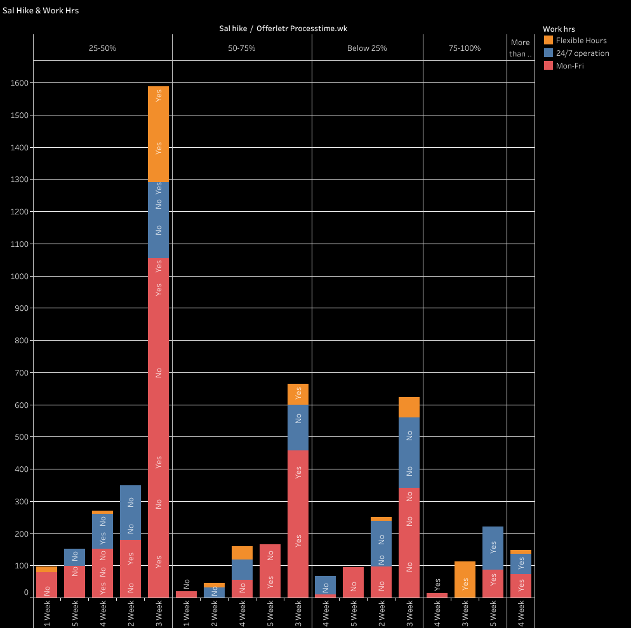

Salary Hike & Work Hrs
Candidates with salary hike of 25-50% and job type as permanent will accept the offer.
Candidates with same salary hike and job type as contract will reject the offer.
Work type with Flexible hours are most likely to accept the offer.

Slide 6
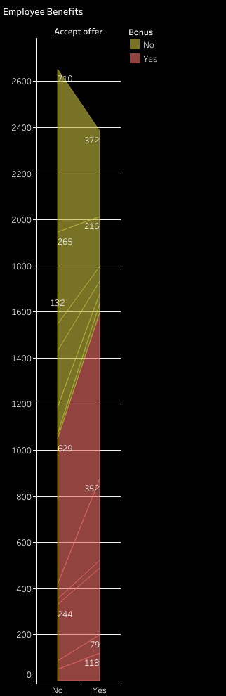

Monetary Benefits
Candidates with no monetary benefits i.e. Performance incentive, Overtime Pay, Employee share scheme, Bonus, etc. will reject the offer.
Alternatively, if one or more benefit other than salary is offered then the candidates will accept the offer.

Slide 7

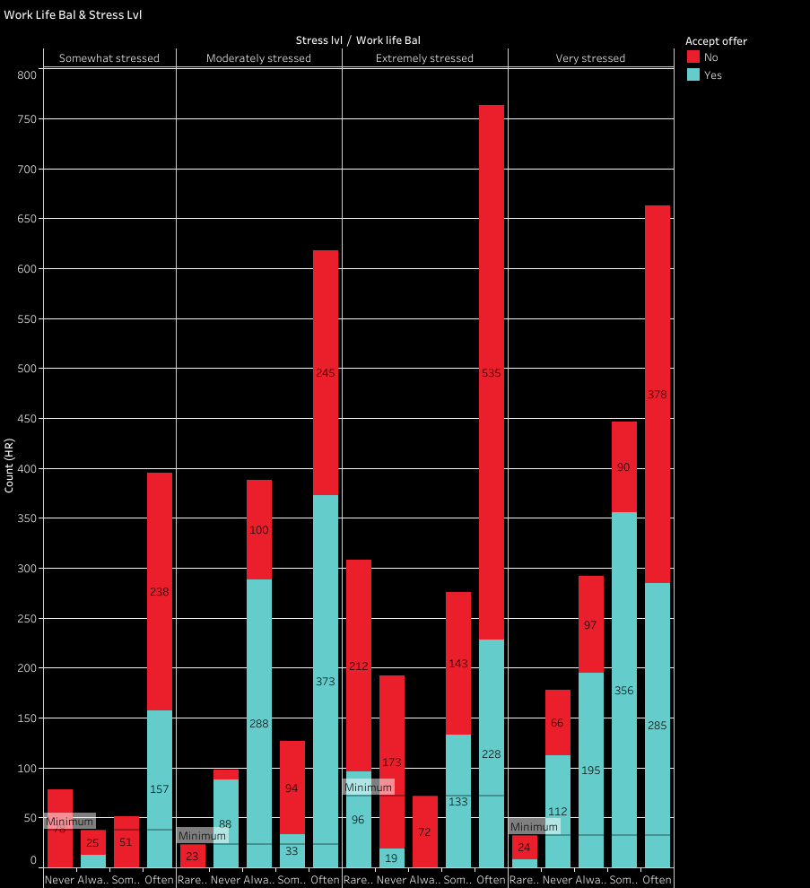
Stress Level & Work Life Balance
Candidates may not accept the offer if the working condition in that organisation is extremely stressful.
Candidates will accept the offer if their work life balance is not affected after joining the organisation.

Slide 8
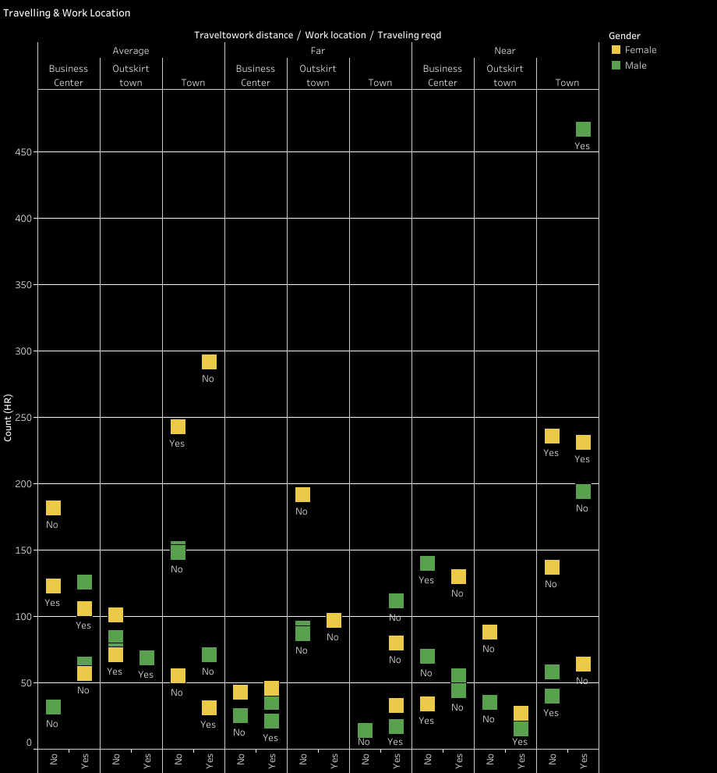

Travelling & Work Location
Most of the Male candidates will accept the offer if the distance from home to work is Near and located in Town.
The major concern for Female candidates will be travelling distance.

Slide 9
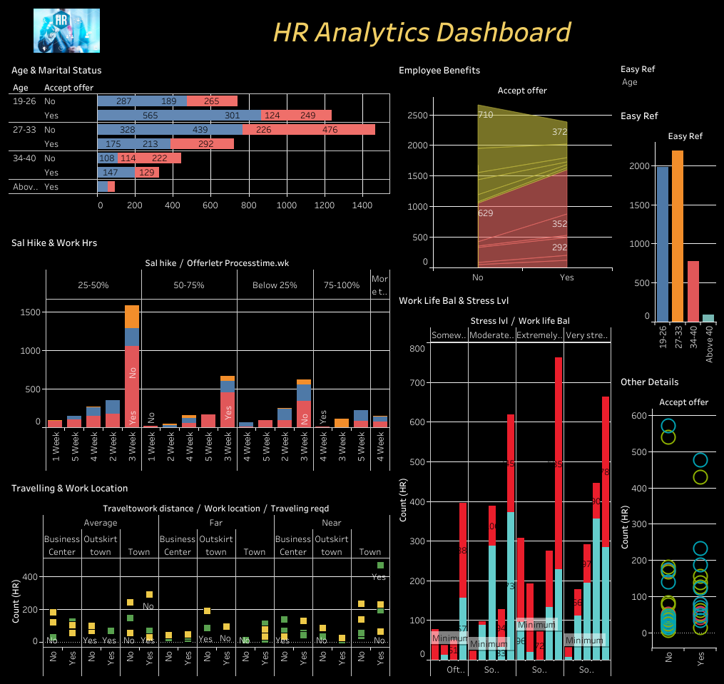
Dashboard
Age
Gender
Marital Status
Salary Hike
Job Type
Accept Offer

Slide 10



